Slide 1
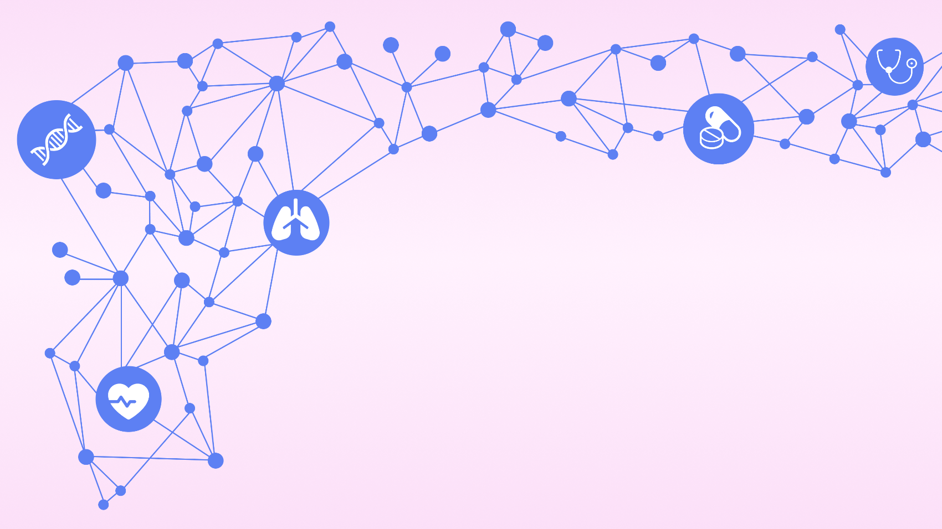
Augmenting Bayesian Networks with Textual Evidence
for Expert-Based, Uncertainty-
Aware Clinical Decision Support
Doctoral dissertation of Paloma Rabaey
Public defense
24/02/2026
Notes:
Welcome everyone at the public defense of my doctoral dissertation. Thank you all for being here. I will be telling you all about the research I did the past 4 years. That’s quite a long time, so let’s dive in quickly!

Slide 2






Artificial intelligence in healthcare
Artificial Intelligence (AI) = computer systems that are able to perform tasks normally requiring human intelligence
In healthcare: Clinical Decision Support Systems
Chatbot
as assistant
Skin cancer detection
ICU warning system
Notes:
When we think about the potential of AI in healthcare, we can come up with may examples. For example, a chatbot that suggests possible diagnoses during a primary care consultation, an app that can flag potentially dangerous skin lesions through a picture, or a monitoring system at the intensive care unit that alerts staff when patients are at risk of developing sepsis. Maybe you have heard of some of these examples before, maybe not. These are all examples of AI systems that are designed to support the judgment of the clinicians and have the potential to transform healthcare. We call these clinical decision support systems.

Slide 3

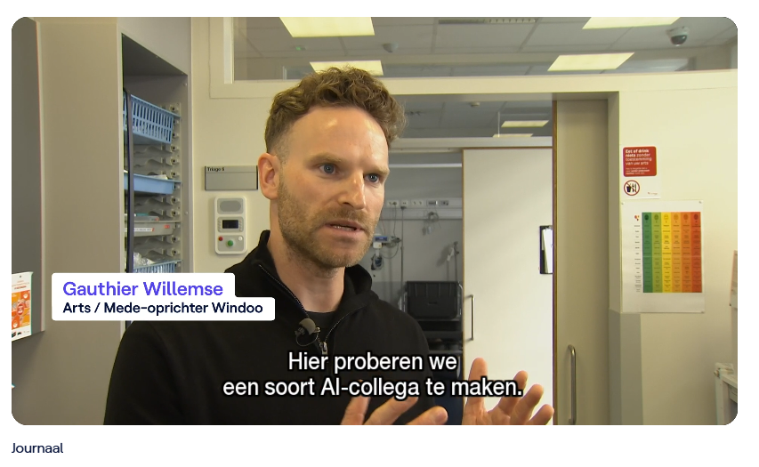
Artificial intelligence enters the emergency room: first talk to an AI assistant before your see a doctor. (VRT NWS, 24/10/2025)
Notes:
Perhaps those systems might sound like a future that is far away, but there are systems like this that are currently implemented in hospitals near us. For example, AZ Sint Lucas has experimented with an AI assistant in their emergency room, that talks to patients before they see a doctor.
https://www.vrt.be/vrtnws/nl/kijk/2025/10/24/video-spoed-ziekenhuis-uz-gent-artificiele-intelligentie?autoplay=true

Slide 4

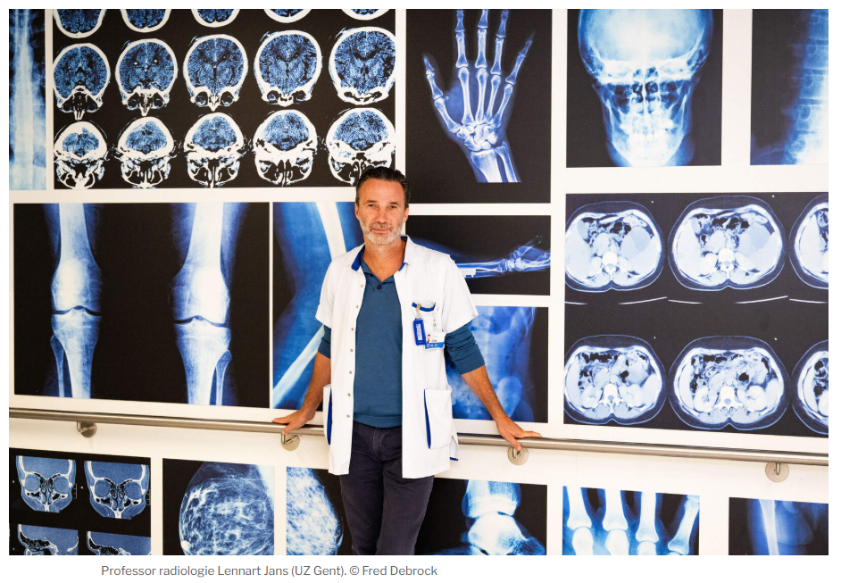
Will AI soon replace doctors? “Doctors who don’t use AI will become replaceable” (De Standaard, 05/09/2025)
Notes:
In the emergency care department of UZ Ghent, AI is used to automatically analyze radiology images, to flag to the emergency care physicians which patients might have internal bleeding and are in need of quick care.
https://www.standaard.be/binnenland/vervangt-ai-binnenkort-de-dokter-de-arts-die-geen-ai-gebruikt-zal-wel-vervangbaar-worden/88318496.html

Slide 5
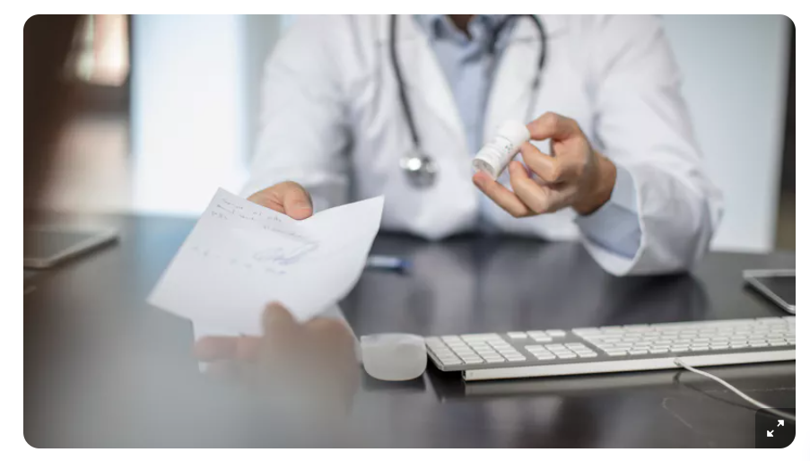
Ghent startup helps general practitioners create consultation reports with AI to reduce administration (Ghent, 16/01/2025)
Notes:
The influence of AI in healthcare goes beyond hospitals, and enters primary care as well, via the general practitioner’s office. There is a startup in Ghent called Squire, which is developing an AI assistant that can create consultation reports to reduce the administrative burden for general practitioners.
https://www.vrt.be/vrtnws/nl/2025/01/16/gentse-start-up-helpt-huisartsen-consultatieverslagen-maken-met/

Slide 6
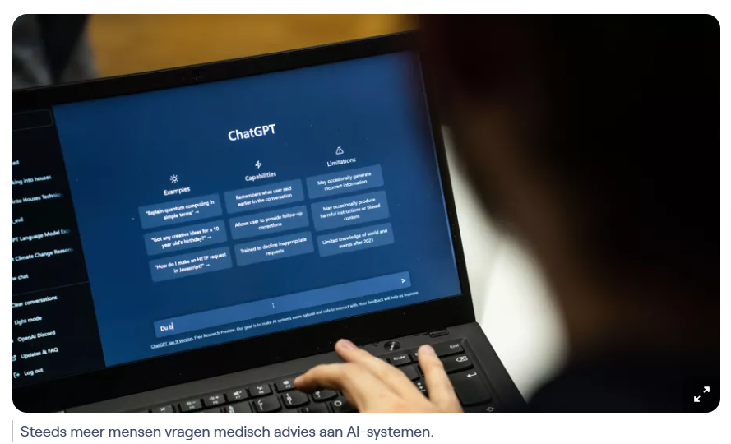
“A chatbot is trying to please us”: why you should not trust doctor AI for medical advice. (VRT NWS, 10/02/2026)
Notes:
Finally, patients are also turning to AI themselves. I’m sure there are many in this room who have asked ChatGPT or another chatbot for medical advice. However, while these AI systems are powerful and certainly useful, we cannot always trust their judgment. So before I tell you all about the work I did for my dissertation, I would like to hear about your opinion on the use of AI in healthcare. While not everyone in this room is a doctor, everyone is a patient, so you can all weigh in from that perspective.
https://www.vrt.be/vrtnws/nl/2026/02/10/dokter-ai-chatgpt/

Slide 7
3.
Augmenting Bayesian Networks
with Textual Evidence
for Expert-Based, Uncertainty-Aware
Clinical Decision Support
4.
2.
1.
Notes:
The title of this dissertation probably contains a lot of words that are new to you, but it describes everything that we will cover today. First, I will tell you about a use case in the doctor’s’s office where an AI can be useful as a support tool to make better clinical decisions. Then, I will tell you about two important properties that such a system must have, so that both the doctor and patient can trust its judgment. Next, I will tell you about Bayesian networks, a type of AI that is almost perfectly suited to be our clinical decision support system. Note that I said almost perfectly suited, because it cannot deal with medical text. In the final step of this presentation, I will tell you about the importance of medical text, and how we can integrate it in the Bayesian network.

Slide 8


Part 1
Clinical decision support for diagnosis in primary care
Notes:
So let’s start with part 1, where I will show to you an interesting use case of how we can support diagnosis in primary care with AI

Slide 9
Cough for 3 days
This morning: fever
No runny nose
Common cold?
Pneumonia?
Diagnosis via clinical reasoning
Notes:
Imagine you’ve been coughing for three days, and this morning, you woke up with a fever. You don’t have a runny nose. You decide to go to the doctor, and tell him your symptoms. Upon hearing your symptoms, the doctor thinks of two possible diagnoses that could explain your symptoms: a common cold, which is annoying but harmless, and can be helped with some cough syrup. Or pneumonia, a much more serious inflammation of the lungs which can be dangerous when untreated. In order to help you, the doctor must make a diagnosis based on your symptoms, meaning that they must decide which of these two candidates is most likely based on your symptoms. To do this, they use a process of clinical reasoning.

Slide 10
What is the prevalence of common cold and pneumonia?
Cough for 3 days
This morning: fever
No runny nose
Common cold: 45%
Pneumonia: 10%
Common cold:
Pneumonia:
Notes:
In clinical reasoning, the doctor keeps track of the probability of some possible diagnoses. As they receive new information, they update these probabilities. Some doctors do this consciously, while others to this subconsciously, but in any case, this process lies at the heart of the reaching a diagnosis in primary care. The doctor starts by considering the prevalence of both diseases. Common cold is much more common than pneumonia. Especially in winter, a large part of patients seen by the doctor have a common cold.

Slide 11
How does cough relate to each diagnosis?
Cough for 3 days
This morning: fever
No runny nose
Common cold: 45%
Pneumonia: 10%
Common cold: 60%
Pneumonia: 25%
Notes:
The doctor then considers all symptoms experienced by the patient. Each symptom will either increase or decrease the probability for a diagnosis. A cough is common in both diagnoses, so it increases the probability.

Slide 12

What is the patient’s temperature?
Cough for 3 days
This morning: fever
No runny nose
Common cold: 60%
Pneumonia: 25%
Common cold: 65%
Pneumonia: 50%
Notes:
The patient mentions a fever. Upon taking the patient’s temperature, the doctor finds that it is high. A low fever is usual for a common cold, but a high fever is much more indicative of pneumonia. So the probability for pneumonia increases once more, while the probability for common cold is not affected much.

Slide 13
How does absence of a runny nose relate to each diagnosis?
Cough for 3 days
This morning: fever
No runny nose
Common cold: 30%
Pneumonia: 50%
Common cold: 65%
Pneumonia: 50%
Action threshold pneumonia: 60%
Notes:
Finally, the patient does not have a runny nose. A runny nose is a very common symptom for a patient with a cold. The fact that the patient has no runny nose, greatly decreases the probability for common cold. The probability for pneumonia remains unaffected, as this symptom is not related to pneumonia whatsoever.
At this point, pneumonia seems like a likely diagnosis. However, the probability is still only 50%. Each clinician has their own action threshold, which decides how certain they need to be of a diagnosis before they take action. In case of pneumonia, this action would be to prescribe antibiotics.

Slide 14
What is an action threshold?
Decides how certain doctors must be of a diagnosis before they decide to take action
Prescribe antibiotics
Refer to specialist
Perform expensive testing
Depends on many factors
Prior experience
Caution of overtreatment
Cost related to treatment
Age
Comorbidity
Risk when misdiagnosed
Notes:
Where the action threshold lies, depends on many factors, like prior experience, caution of antibiotics resistance, costs related to therapy, risks of disease when it goes undiagnosed, etc. It can also depend on the demographics of the patient, like their age.

Slide 15
Cough for 3 days
This morning: fever
No runny nose
Cough for 3 days
This morning: fever
No runny nose
Difficulty breathing
Does the patient have difficulty breathing?
Common cold: 30%
Pneumonia: 50%
Common cold: 30%
Pneumonia: 65%
Action threshold pneumonia: 60%
Notes:
Let’s say that in this case, the action threshold for pneumonia lies at 60%. The doctor does not want to prescribe antibiotics unnecessarily, as this is expensive and promotes unnecessary antibiotics resistance, but they also don’t want to run too high of a risk of missing pneumonia, as this can have dire consequences for the patient. So, the doctor needs more information in order to rule out or confirm pneumonia before taking action. The doctor knows that difficulty breathing is another common symptom in the case of pneumonia. Therefore, they ask the patient whether they have difficulty breathing, and it turns out that they do. This increases the probability of pneumonia to 65%, which exceeds the action threshold. This means that the doctor will prescribe antibiotics to cure the patient’s pneumonia.

Slide 16
The patient likely has pneumonia, so treat with antibiotics.
Cough for 3 days
This morning: fever
No runny nose
Difficulty breathing
Common cold: 30%
Pneumonia: 65%
Common cold: 30%
Pneumonia: 65%
Action threshold pneumonia: 60%
Notes:
Now, the action threshold has been exceeded, and the doctor decides that the patient likely has pneumonia, which needs to be treated with antibiotics.

Slide 17
What can go wrong?
Doctors can make mistakes
Do not consider all possible diagnoses
Incorrect estimation of prevalence
Misjudge how a symptom relates to a diagnosis
Forgets to ask about a crucial symptom
…
Can we build an AI that supports the clinical reasoning process of the doctor?
Notes:
While doctors are highly trained professionals, they are human and can make mistakes. For example, they might not consider all possible diagnoses, or they might incorrectly estimate the prevalence of a disease. Or perhaps they misjudge how a symptom relates to a diagnosis, or they might forget to ask about a crucial symptom. To empower and support the doctor in their diagnostic process, we wondered whether we can build an AI assistant that can support the clinical reasoning process of the doctor.

Slide 18
Cough
Fever
Nasal symptoms
Difficulty breathing
Common cold: 45%
Pneumonia: 10%
Patient has respiratory complaints
Notes:
What would such an AI look like?
The AI can keep track of the probability of all possible diagnoses. The doctor can ask questions and input symptoms, and see how the probabilities are updated automatically by the AI.
When the doctor tells the AI that the patient has respiratory complaints, the AI can list possible diagnoses, and keeps track of symptoms that are important to track for such diagnoses.

Slide 19
Cough
Fever
Nasal symptoms
Difficulty breathing
Cough
Fever
Nasal symptoms
Difficulty breathing
Common cold: 30%
Pneumonia: 60%
Common cold: 45%
Pneumonia: 10%
Patient has a cough, high fever, and no nasal symptoms
Notes:
The doctor can input the patient’s symptoms, and the AI automatically updates the probabilities for each diagnosis based on this.

Slide 20
Cough
Fever
Nasal symptoms
Difficulty breathing
Common cold: 30%
Pneumonia: 60%
What symptom should I ask about next?
Difficulty breathing
Notes:
The doctor can also ask whether there are any important symptoms that they need to ask about. In this case, the AI has information about all symptoms except for difficulty breathing, so it recommends asking information to the patient about this, in order to finetune its probabilities even more.

Slide 21
Keeps track of:
Diagnoses, probabilities, symptoms
Clinical decision support system
Inputs
information
Provides recommen-
dations
Notes:
Imagine the doctor has access to an AI assistant, that keeps track of differential diagnoses, possible related symptoms, probabilities, prevalence of symptoms and diagnoses, etc. This way, the doctor does not need to keep track of all this information by themselves. Instead, they can ask information to the AI. The AI serves as an assistant to the doctor, outputting recommendations upon the information it receives. However, the doctor still has the final say about the diagnosis and subsequent treatment. The AI simply supports clinical decisions.

Slide 22

Part 2
The need for interpretable, expert-based and uncertainty-aware AI
Notes:
Now that we have motivated why an AI might be a useful assistant in the clinical reasoning process, we can turn to the requirements we have for such an AI: we need it to be interpretable, expert-based and uncertainty-aware

Slide 23



Two major requirements for our AI system
1.
Doctor and patient
trust the system
2.
The system is uncertainty-aware
Notes:
We have two major requirements for our AI system. First, both doctor and patient must be able to trust the system. Second, the system should be uncertainty-aware.

Slide 24
1. Doctor and patient trust the system
Cough, high fever, no nasal symptoms, difficulty breathing
Patient has pneumonia
?
?
Black
box
Notes:
Let’s consider an AI that takes in the patient’s symptoms, and gives a most likely prediction for the patient’s diagnosis, without explanation or insight into how this diagnosis was obtained. Here, the doctor has no idea how the AI came to this diagnosis. Such a recommendation is useless, as the doctor cannot trust where it came from, and cannot explain to the patient why a decision is made. If the doctor does not trust the system, they will not take its recommendations into account for making their decisions. If the patient does not trust the system, then the doctor-patient relationship is tainted. These types of systems are called black box systems, because you literally cannot see their inner workings. Many of the popular AI methods today are black boxes, including popular large language models like ChatGPT.

Slide 25

1. Doctor and patient trust the system
Cough, high fever, no nasal symptoms, difficulty breathing
Patient has pneumonia, because…
Cough, high fever: Pneumonia
No nasal symptoms: Common cold
Interpretable
Notes:
Instead, we need a system that can explain and motivate its explanations. When the doctor can understand why a recommendation is made, he can trust the recommendation and explain it to the patient. We call these types of systems interpretable. It should be as if we can look inside the inner thought process of the AI.

Slide 26
2. The system is uncertainty-aware
?
Patient has pneumonia
Action threshold pneumonia: 60%
Notes:
As we’ve discussed before, every clinician has an action threshold, which depends on the context of the patient, the disease, and many other factors. This is an important part of the clinical reasoning process. If the AI system does not communicate the confidence of a diagnosis to the doctor, they cannot integrate this into their clinical reasoning process.

Slide 27
2. The system is uncertainty-aware
Order additional testing
Chance of pneumonia: 50%
Action threshold pneumonia: 60%
Notes:
However, if the AI communicates its level of certainty to the doctor, the doctor can take this information into their clinical reasoning process, and reliably make a follow-up decision. For example, if the probability of pneumonia predicted by the AI is only 50%, then this does not exceed the action threshold of the clinician, and they might order additional testing to rule out pneumonia.

Slide 28
2. The system is uncertainty-aware
Treat with antibiotics
Chance of pneumonia: 90%
Action threshold pneumonia: 60%
Notes:
If the AI predicts a 90% probability of pneumonia, then the clinician may decide that the action threshold is reached, and prescribe antibiotics to treat pneumonia

Slide 29
Two major requirements for our AI system
1.
Doctor and patient
trust the system
2.
The system is uncertainty-aware
Notes:
So how can we build a system that fulfills both requirements?

Slide 30
Part 3
Bayesian networks
Notes:
So what are Bayesian networks?

Slide 31
Bayesian network
Expert-defined causal structure
Difficulty breathing
Pneumonia
Cough
Common cold
Fever
Runny nose
Notes:
So what is a Bayesian network? Let’s build up a Bayesian network for our use case of diagnosing respiratory diseases step by step. First, a Bayesian network defines a causal structure of how each variable can influence other variables. The word causal refers to the idea of cause and effect: one thing may cause the appearance of another thing. For example, pneumonia can cause cough. We draw an arrow from pneumonia to cough to reflect this. Another possible cause of cough, is a common cold. We can keep adding symptoms in this way. Who decides what cause-effect relations are? Experts (doctors who are specialized in the field of respiratory diseases) can give us this information.

Slide 32
Bayesian network
Difficulty breathing
Difficulty breathing
Pneumonia
Pneumonia
Cough
Common cold
Fever
Runny nose
Notes:
But that is not all that defines a Bayesian network. A Bayesian network also models probabilities. To understand how it does this, let’s zoom in on one part of the network.

Slide 33
Bayesian network
Pneumonia
Difficulty breathing
The probability that a patient suffers from difficulty breathing when they have pneumonia, is 60%.
Conditional probability
P(difficulty breathing | pneumonia) = 60%
P(no difficulty breathing | pneumonia) = 40%
Notes:
Though we know that there is a causal link between pneumonia and difficulty breathing, this symptom does not always occur. Some patients who have pneumonia, do not suffer from difficulty breathing. There is some probability with which they suffer from difficulty breathing. We call this a conditional probability.

Slide 34
Bayesian network
Pneumonia
Difficulty breathing
The probability that a patient suffers from difficulty breathing when they do not have pneumonia, is 20%.
Conditional probability
P(difficulty breathing | no pneumonia) = 20%
P(no difficulty breathing | no pneumonia) = 80%
Notes:
But how can we learn these conditional probabilities?

Slide 35

Bayesian network
The probability that a patient suffers from difficulty breathing when they have pneumonia is …
Pneumonia
Difficulty breathing
Patient | Pneumonia | Difficulty breathing
1 | yes | yes
2 | yes | no
3 | no | yes
4 | no | no
5 | yes | yes
Patient | Pneumonia | Difficulty breathing
6 | no | no
7 | yes | yes
8 | no | no
9 | no | no
10 | yes | no
Notes:
We can learn them from data. We can observe 10 patients, and for every patient, we note down whether they have pneumonia and difficulty breathing. Then, we want to find out how often the symptom of difficulty breathing occurs when a patient has pneumonia.

Slide 36
Bayesian network
The probability that a patient suffers from difficulty breathing when they have pneumonia is …
Pneumonia
Difficulty breathing
Patient | Pneumonia | Difficulty breathing
1 | yes | yes
2 | yes | no
3 | no | yes
4 | no | no
5 | yes | yes
Patient | Pneumonia | Difficulty breathing
6 | no | no
7 | yes | yes
8 | no | no
9 | no | no
10 | yes | no
Notes:
We can learn them from data. We can observe 10 patients, and for every patient, we note down whether they have pneumonia and difficulty breathing. Then, we want to find out how often the symptom of difficulty breathing occurs when a patient has pneumonia. So we select all cases where the patient has pneumonia, and we count how often difficulty breathing occurs. Here, it’s 3 out of 5 times, or 60%.

Slide 37
Bayesian network
The probability that a patient suffers from difficulty breathing when they have pneumonia is …
Pneumonia
Difficulty breathing
60%
Patient | Pneumonia | Difficulty breathing
1 | yes | yes
2 | yes | no
3 | no | yes
4 | no | no
5 | yes | yes
Patient | Pneumonia | Difficulty breathing
6 | no | no
7 | yes | yes
8 | no | no
9 | no | no
10 | yes | no
Notes:
We can learn them from data. We can observe 10 patients, and for every patient, we note down whether they have pneumonia and difficulty breathing. Then, we want to find out how often the symptom of difficulty breathing occurs when a patient has pneumonia. So we select all cases where the patient has pneumonia, and we count how often difficulty breathing occurs. Here, it’s 3 out of 5 times, or 60%.

Slide 38
Bayesian network
Pneumonia
Difficulty breathing
 | Pneumonia | No pneumonia
Difficulty breathing | 60% | 20%
No difficulty breathing | 40% | 80%
Conditional probability table
Notes:
We can learn all the other conditional probabilities from the dataset as well. When we arrange all probabilities in a table, which we call a conditional probability table.

Slide 39

Bayesian network
= causal structure + conditional probability tables
Difficulty breathing
Pneumonia
Cough
Common cold
Fever
Runny nose
Notes:
In a Bayesian network, we can learn such a table for every variable, as long as we have a dataset that contains information about all these variables.

Slide 40
Bayesian networks
Expert-defined causal structure
Conditional probability tables
Notes:
Bayesian networks are a type of AI model which is made up of two crucial parts: an expert-defined causal structure, and a conditional probability table.

Slide 41
Clinical reasoning with a Bayesian network
Target | Evidence
Pneumonia = yes
Difficulty breathing
P(Pneumonia = yes) = 10%
What is the prevalence of pneumonia?
Pneumonia
Cough
Common cold
Fever
Runny nose
Notes:
Now that we have our Bayesian network, a doctor can use it to answer questions which are central to clinical reasoning. For example, they can ask what the prevalence of pneumonia is. The Bayesian network always receives two inputs: an evidence set, and a target set. These indicate the variables that are relevant to the question. The Bayesian network can then formulate an answer, by calculating the probability of the target variable, given the value of the evidence variable.

Slide 42
Clinical reasoning with a Bayesian network
Bayesian inference
Target | Evidence
Pneumonia = yes | Cough = yes Fever = high Runny nose = no
P(Pneumonia = yes |
Cough = yes, Fever = yes, Runny nose = no) = 50%
Difficulty breathing
What is the chance of pneumonia, given the symptoms?
Pneumonia
Cough
Common cold
Fever
Runny nose
Notes:
We can ask more complicated questions which involve multiple variables. Such as, what is the chance of pneumonia, given the patient’s symptoms? Remember, our patient came into the doctor’s office with a cough, a high fever, and no nasal symptoms. This can be translated into evidence for the Bayesian network. The Bayesian network can read off all the relevant probabilities in the probability tables, and combine these probabilities into the probability for pneumonia, given all this evidence. This process is called Bayesian inference, and it is fully transparent and built on probability theory.

Slide 43
Clinical reasoning with a Bayesian network
Target | Evidence
Pneumonia = yes | Cough = yes Fever = high Nasal = no Difficulty breathing = yes
Target | Evidence
Pneumonia = yes | Cough = yes Fever = high Nasal = no
P(Pneumonia = yes |
Cough = yes, Fever = yes, Nasal = no, Difficulty breathing) = 65%
P(Pneumonia = yes |
Cough = yes, Fever = yes, Nasal = no) = 50%
Difficulty breathing
Will this chance increase if the patient also has difficulty breathing?
Pneumonia
Cough
Common cold
Fever
Nasal
Notes:
Then, the doctor can continue their process of clinical reasoning, and ask whether this chance will increase if the patient has difficulty breathing. The Bayesian network integrates the information as well, and answers that the chance will increase to 65%. The doctor now knows that it would be worthwhile the ask the patient whether they have difficulty breathing.

Slide 44
Keeps track of:
Diagnoses, probabilities, symptoms
Clinical decision support system
Inputs
information
Provides recommen-
dations
Notes:
Imagine the doctor has access to an AI assistant, that keeps track of differential diagnoses, possible related symptoms, probabilities, prevalence of symptoms and diagnoses, etc. This way, the doctor does not need to keep track of all this information by themselves. Instead, they can ask information to the AI. The AI serves as an assistant to the doctor, outputting recommendations upon the information it receives. However, the doctor still has the final say about the diagnosis and subsequent treatment. The AI simply supports clinical decisions.

Slide 45
Two major requirements for our AI system
1.
Doctor and patient
trust the system
2.
The system is uncertainty-aware
Notes:
So, with the Bayesian network, we have found an AI system that can partially automate the process of clinical reasoning. Does it fit our requirements?

Slide 46
1.
Doctor and patient
trust the system
Difficulty breathing
Pneumonia
Cough
Interpretable causal structure
Interpretable Bayesian inference process
Expert-based
Common cold
Fever
Runny nose
Notes:
The users can trust the system, because it is fully interpretable. Both the causal structure of the BN is interpretable by a human, as is the Bayesian inference process. Furthermore, the users can trust that the knowledge the BN is built on is sound, as the causal structure is built by experts.

Slide 47
2.
The system is uncertainty-aware
Difficulty breathing
Pneumonia
Cough
Conditional probabilities are at the center of the Bayesian network
Probabilistic output of Bayesian inference
Common cold
Fever
Runny nose
Notes:
Second, the system is certainly uncertainty-aware, as conditional probabilities are at the center of the Bayesian network. The output of the Bayesian inference process is always a probability.

Slide 48

Part 4
Augmenting Bayesian
networks with medical
text
Notes:
Bayesian networks already existed, so what is my contribution to the field of AI? It is to augment these Bayesian networks with medical text

Slide 49
The abundance of medical text
Consultation notes
Discharge summaries
Radiology reports
Notes:
Medical text is abundant in clinical practice.

Slide 50
The abundance of medical text
Patient was here on Wednesday and was diagnosed with COVID-19. Feels like it's gotten worse. Mainly coughing, general muscle aches, and headaches. No shortness of breath. Mild fever. Impression of irregular heartbeat, no palpitations, and blood pressure monitor indicated a low heart rate. Is a bit worried.
Objective: irregular heartbeat, with streaks of faster and slower rhythms. Pulse 43/min, RR 13/7, sat 98%.
In consultation with the cardiology resident, was referred to emergency room for cardiac monitoring. Patient refuses to go. All the risks were explained, patient is aware of them.
Consultation notes
TODO: Stefan
TODO: Stefan
Discharge summaries
Radiology reports
Notes:
For example, when you go to the general practitioner, you might have noticed that they are usually making notes while talking to you. These consultation notes are stored in the electronic patient file, and can be useful to the doctor later when they are reviewing your case, or when they need to explain a referral. As you can see, these notes are dense and can contain a lot of information, but this all depends on the doctor who writes them, and on the level of complexity of the consultation.

Slide 51
The abundance of medical text
__ year old male with stage IIIB esophageal adenocarcinoma s/p neoadjuvant chemo/XRT prior to esophagectomy in __ who presented with fevers, nausea and vomiting. #Fever: he was treated broadly with vancomycin and cefepime in the ED. He had a CXR, UA and CT abdomen /
pelvis that did not show a source of infection. He was felt to most likely have a viral gastroenteritis. His shoulder lesion which had been positive on recent __ was not painful and he had full ROM in his shoulder joint and it was felt to be unlikely to be infected. He was monitored in the hospital off antibiotics for >24 hrs.
Consultation notes
TODO: Stefan
TODO: Stefan
Discharge summaries
Radiology reports
Notes:
Clinical notes can also be found in the hospital. After you are released from the hospital, the clinicians who treated you write a discharge summary. This document can be multiple pages long, and contains the main points of what happened while you were in the hospital. It contains why you came in, but also the treatment they gave you, certain decisions they made, what medicine they prescribed upon discharge, and more.

Slide 52
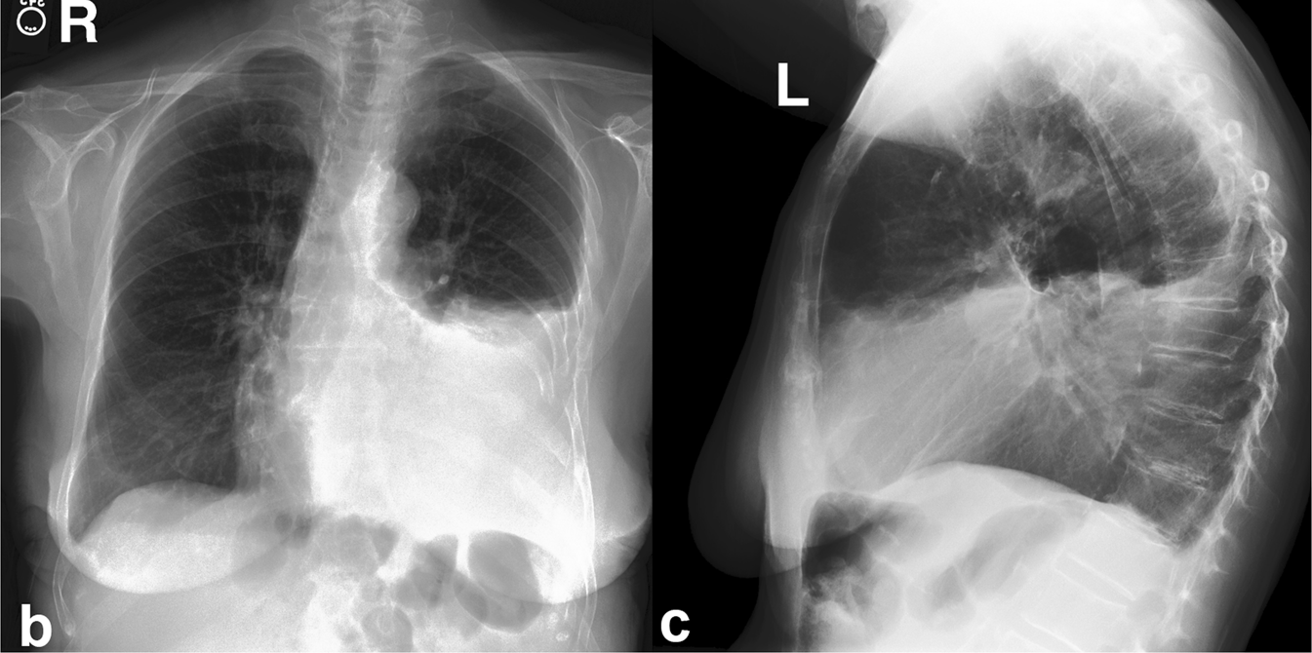
The abundance of medical text
TECHNIQUE: Chest PA and lateral
FINDINGS: Cardiac size cannot be evaluated. Large left pleural effusion is new. Small right effusion is new. The upper lungs are clear. Right lower lobe opacities are better seen in prior CT. There is no pneumothorax. There are mild degenerative changes in the thoracic spine.
IMPRESSION: large left pleural effusion
Consultation notes
TODO: Stefan
TODO: Stefan
Discharge summaries
Radiology reports
Notes:
Another type of medical text that occurs often, are radiology reports. These are written by radiologists who are interpreting medical images, like X-rays. On the right, you see a chest X-Ray report, where the radiologist describes what they see.

Slide 53
Medical text contains information
Patient has had a hacking cough for the past 3 days. She also has a fever, but she is not sure when this started. She does not complain of nasal symptoms. Patient may have pneumonia, but more testing is required.
Patient has had a hacking cough for the past 3 days. She also has a fever, but she is not sure when this started. She does not complain of nasal symptoms. Patient may have pneumonia, but more testing is required.
Consultation notes
TODO: Stefan
TODO: Stefan
Severity and extra context on symptoms
Notes:
These medical text contains a lot of information. Let’s focus on the consultation notes for now, since they are relevant to our primary care use case. On the right, you see a fictional consultation note that might have been written about our patient with respiratory complaints. It contains context on the severity of symptoms, like is the case for cough.

Slide 54
Medical text contains information
Patient has had a hacking cough for the past 3 days. She also has a fever, but she is not sure when this started. She does not complain of nasal symptoms. Patient may have pneumonia, but more testing is required.
Patient has had a hacking cough for the past 3 days. She also has a fever, but she is not sure when this started. She does not complain of nasal symptoms. Patient may have pneumonia, but more testing is required.
Consultation notes
TODO: Stefan
Severity and extra context on symptoms
Indications of uncertainty
Notes:
Or, the text may give a nuanced view of the presence or absence of certain symptoms. Here, the text is uncertain about the start of the fever, and the writer also conveys uncertainty about the presence of pneumonia, through the use of the phrase “may”.

Slide 55
Why is text useful in our Bayesian network?
Bayesian inference
Target | Evidence
Pneumonia = yes | Cough = yes Fever = high Runny nose = no
P(Pneumonia = yes |
Cough = yes, Fever = yes, Runny nose = no) = 50%
Difficulty breathing
Pneumonia
Cough
Common cold
Fever
Runny nose
Notes:
Remember, previously, I showed you how you can provide evidence to the Bayesian network, and how it can answer your questions about a target variable. Through the process of Bayesian inference, it can calculate a conditional probability, aka the probability that the target variable takes on a certain value

Slide 56
Why is text useful in our Bayesian network?
Bayesian inference + text
Target | Evidence
Pneumonia = yes | Cough = ? Fever = high Runny nose = no
P(Pneumonia = yes |
Cough = text, Fever = yes, Runny nose = no) = ?
Difficulty breathing
Patient has had a hacking cough for the past 3 days. She also has a fever, but she is not sure when this started. Patient may have pneumonia, but more testing is required.
Patient has had a hacking cough for the past three days…
Pneumonia
Cough
TODO: Stefan
Common cold
Fever
Information extraction
Runny nose
Notes:
But what if we do not have a full set of tabular evidence? Perhaps, instead of a yes/no indication for cough, we have a text that describes the patient’s symptoms instead. How can we integrate the information that is contained in this text into the Bayesian inference process? For this, we need to extract information on the symptom of cough from the text.

Slide 57
Medical text contains information
Patient has had a hacking cough for the past 3 days. She also has a fever, but she is not sure when this started. Patient may have pneumonia, but more testing is required.
Patient has had a hacking cough for the past 3 days. She also has a fever, but she is not sure when this started. Patient may have pneumonia, but more testing is required.
Consultation notes
TODO: Stefan
Severity and extra context on symptoms
Indications of uncertainty
Information extraction
Notes:
Or, the text may give a nuanced view of the presence or absence of certain symptoms. Here, the text is uncertain about the start of the fever, and the writer also conveys uncertainty about the presence of pneumonia, through the use of the phrase “may”. The process of distilling this information from the text, is called information extraction

Slide 58
Extracting information from text
Information extraction = extracting and encoding information from unstructured clinical text into a structured format
Patient has had a hacking cough for the past 3 days. She also has a fever, but she is not sure when this started. Patient may have pneumonia, but more testing is required.
Patient has had a hacking cough for the past 3 days. She also has a high fever, but she is not sure when this started. She does not complain of nasal symptoms. Patient may have pneumonia, but more testing is required.
TODO: Stefan
variable | value
cough | yes
fever | yes
Notes:
Information extraction is the process of extracting and encoding information from clinical text into a structured format. What information we extract depends heavily on the use case. Sometimes, we may want yes/no labels for the symptoms mentioned in the text.

Slide 59
Medical text contains information
Information extraction = extracting and encoding information from unstructured clinical text into a structured format
Patient has had a hacking cough for the past 3 days. She also has a fever, but she is not sure when this started. Patient may have pneumonia, but more testing is required.
Patient has had a hacking cough for the past 3 days. She also has a high fever, but she is not sure when this started. Patient may have pneumonia, but more testing is required.
TODO: Stefan
variable | value | attributes
cough | yes | Type = hacking Time = 3 days
fever | yes | Severity = high Time = not sure
Notes:
Other times, we may want to extract as much information as possible. So not only the symptoms themselves, but also the attributes that describe the symptoms. How can we do information extraction? For this, we can train AI models

Slide 60
Medical text contains information
Information extraction = extracting and encoding information from clinical text into a structured format
Patient has had a hacking cough for the past 3 days. She also has a fever, but she is not sure when this started. Patient may have pneumonia, but more testing is required.
Patient has had a hacking cough for the past 3 days. She also has a high fever, but she is not sure when this started. Patient may have pneumonia, but more testing is required.
TODO: Stefan
variable | value | attributes | prob
cough | yes | Type = hacking Time = 3 days | 100%
fever | yes | Time = not sure Severity = high | 100%
Pneu- monia | yes |  | 40%
Notes:
Other times, we may want to extract a probability for the presence of the symptoms and diseases that are mentioned in the text. Here, the is no doubt about the presence of cough and fever, but there is doubt about the presence of pneumonia. We could develop a system that maps phrases used to convey doubt to a probability. Here, “may” could indicate a probability of 40%.

Slide 61

Training an AI for information extraction
Patient has had a hacking cough for the past 3 days. She also has a fever, but she is not sure when this started. Patient may have pneumonia, but more testing is required.
Patient has had a hacking cough for the past 3 days. She also has a high fever, but she is not sure when this started.
TODO: Stefan
variable | value
cough | yes
fever | yes
variable | value
cough | 90%
fever | 75%
Notes:
How can we train an AI model to do this? The AI model is a neural network, which can automatically learn to turn any input into any output. It learns this from examples. In the case of information extraction, the examples are text, and the AI must learn to fill in the structured table correctly. It must fill the table with a probability that the symptom is present in the text.

Slide 62
Training an AI for information extraction
Patient has had a hacking cough for the past 3 days. She also has a fever, but she is not sure when this started. Patient may have pneumonia, but more testing is required.
Patient has had a hacking cough for the past 3 days. She also has a high fever, but she is not sure when this started.
TODO: Stefan
variable | value
cough | 45%
fever | 80%
yes
yes
Notes:
Here, the AI guesses a low probability for cough and a high probability for fever. Now, we want our AI to improve, so we show it what it should have guessed. In this case, the text mentions no cough, but a fever, so the AI should have outputted a low probability for cough, and a high probability for fever. We show this to the AI, and through some magic AKA mathematics, the neural network learns to update itself. Next time we show it a similar example, it should perform a little better.

Slide 63
Training an AI for information extraction
Patient has had a hacking cough for the past 3 days. She also has a fever, but she is not sure when this started. Patient may have pneumonia, but more testing is required.
Patient has had a hacking cough for the past 3 days. She also has a high fever, but she is not sure when this started.
TODO: Stefan
variable | value
cough | 75%
fever | 95%
Notes:
Here, fever is closer to 100%, and cough is closer to 0%, which aligns with the true labels in the training data.

Slide 64

Training an AI for information extraction
Text
classifier
Notes:
We can show the AI many examples, and each time the neural network can update itself to become a little better. In the end, we have an AI that can fill in the table well on its own for a new text. We can call this a text classifier.

Slide 65
How can we use text in our Bayesian network?
Extract information from text
Use it to learn conditional probabilities
Difficulty breathing
Pneumonia
Cough
Common cold
Fever
Nasal symptoms
Notes:
Remember that the conditional probability tables in our Bayesian network are learned from data. Since text is also data that contains a lot of information, we can first extract the variables in our Bayesian network from the data. Then, we can learn our conditional probability tables.

Slide 66
How can we use text in our Bayesian network?
Bayesian inference
Target | Evidence
Pneumonia = yes | Cough = yes Fever = high Nasal = no
P(Pneumonia = yes |
Cough = yes, Fever = yes, Nasal = no) = 50%
Difficulty breathing
Pneumonia
Cough
Common cold
Fever
Nasal
Notes:
We can also use text as evidence in the Bayesian network. Remember, previously, I showed you how you can provide evidence to the Bayesian network, and how it can answer your questions about a target variable. Through the process of Bayesian inference, it can calculate a conditional probability, aka the probability that the target variable takes on a certain value

Slide 67
How can we use text in our Bayesian network?
Bayesian inference + text?
Target | Evidence
Pneumonia = yes | Fever = high Runny nose = no
P(Pneumonia = yes |
Cough = text, Fever = yes, Runny nose = no) = ?
Difficulty breathing
Patient has had a hacking cough for the past 3 days. She also has a fever, but she is not sure when this started. Patient may have pneumonia, but more testing is required.
Patient has had a hacking cough for the past three days
TODO: Stefan
Pneumonia
Cough
Common cold
Fever
Runny nose
Notes:
Now that we know that we can extract information from the text with a text classifier, we can return to our Bayesian network. Remember, some part of the evidence is available in textual format, instead of regular tabular format. We want to integrate this textual evidence into the Bayesian inference procedure. How can we do this?

Slide 68
Bayesian inference with textual evidence
Patient has had a hacking cough for the past 3 days. She also has a fever, but she is not sure when this started. Patient may have pneumonia, but more testing is required.
Patient has had a hacking cough for the past three days
TODO: Stefan
Target | Evidence
Pneumonia = yes | Fever = high Runny nose = no
Cough_{Text} = yes
P(Pneumonia = yes |
Cough_{Text} = yes, Fever = yes, Runny nose = no) = 60%
Difficulty breathing
Pneumonia
Cough
Cough_{Text}
Common cold
Fever
P(Cough | Text) = 80%
Runny nose
Notes:
Well, we can use a text classifier that we have trained to recognize cough from a text. This classifier outputs the probability that the patient has a cough after seeing the text. In this case, it predicts this at 80%. We can then use this probability to fill in the conditional probability table for a new variable in the network, the Cough Text variable. This variable captures whether the text contains some information about the symptom cough. Because it is simply another variable in the network, we can use it as evidence in the Bayesian inference procedure. So how can we get the probability of pneumonia, given both the normal and virtual evidence? We turn the Cough Text variable on, as we observe some information from the text. Apart from this, we just input the regular evidence as normal, and use Bayesian inference to propagate all this information into a conditional probability for pneumonia.

Slide 69
Augmenting Bayesian networks with text
Symptom
Symptom
Symptom
Symptom
Symptom_{Text}
Symptom_{Text}
Virtual evidence
Consistency node
Discriminative BN-text
Generative BN-text
Notes:
Apart from this virtual evidence method, I also explored other methods to augment Bayesian networks with textual evidence. In my dissertation, I explored four methods, and compared their advantages and disadvantages for different use cases. We don’t have time to get into it now, so if you’re curious, feel free to find a quiet place during the reception to read my 270 page dissertation!

Slide 70
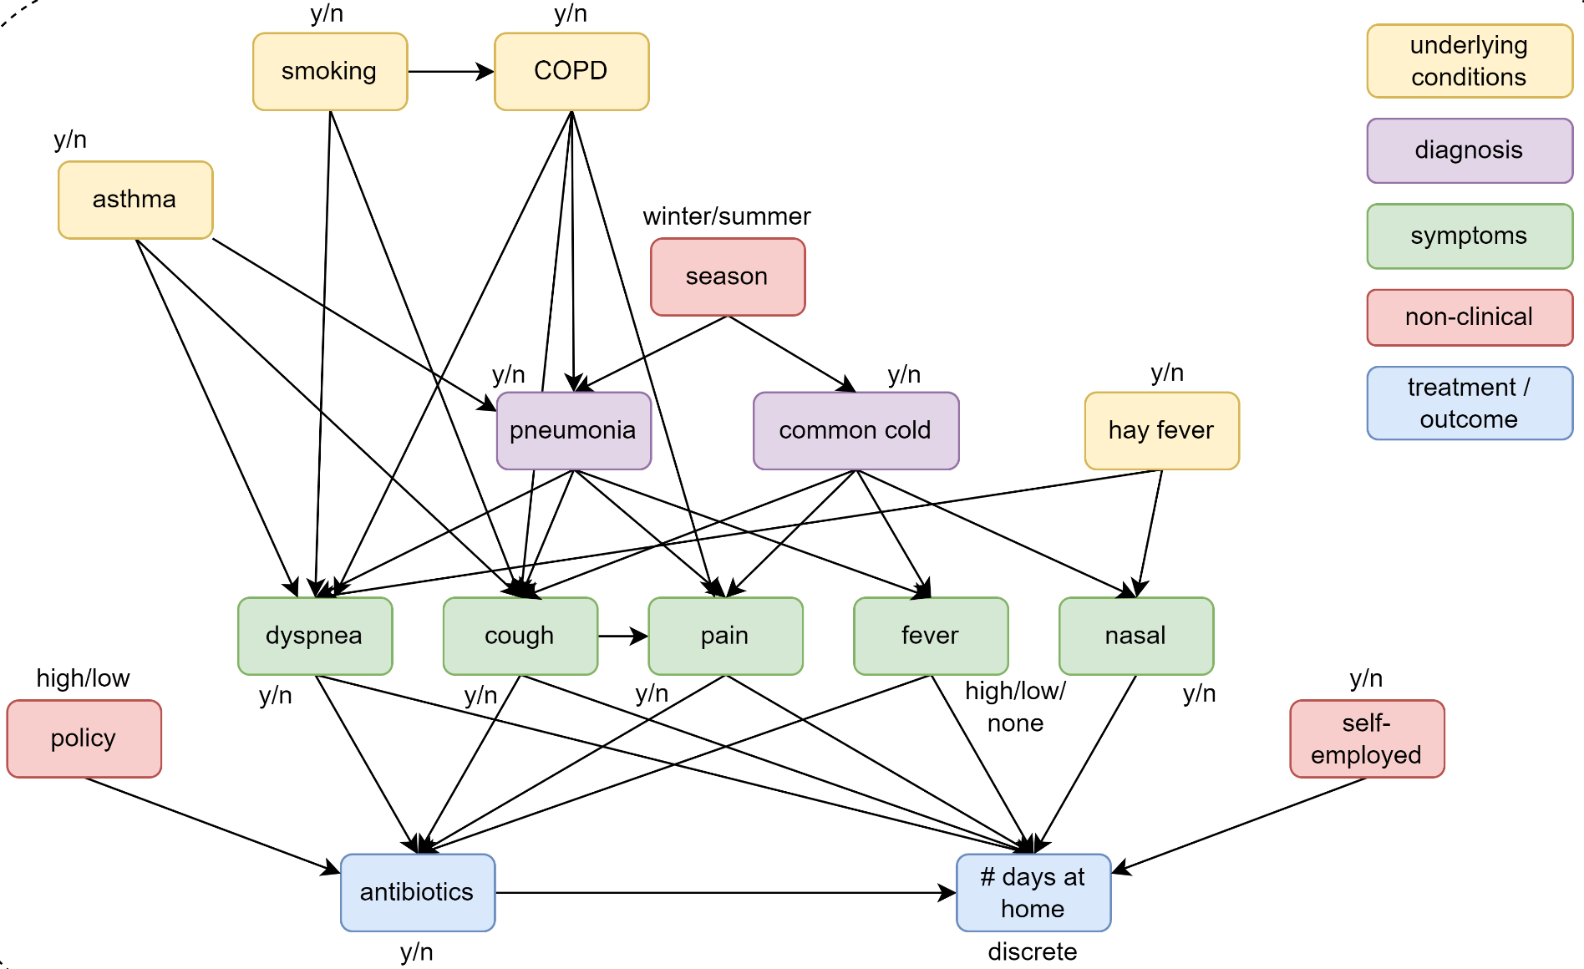
Larger Bayesian network: SimSUM
Notes:
In that dissertation, you will also find that I did a lot more than I had time to address in this presentation. In this presentation, I showed quite a simple Bayesian network. But in my work, this is the actual network that I worked with, which is bigger and contains a wider variety of nodes. My co-supervisor Stefan designed this network for the use case of respiratory diseases in primary care.

Slide 71
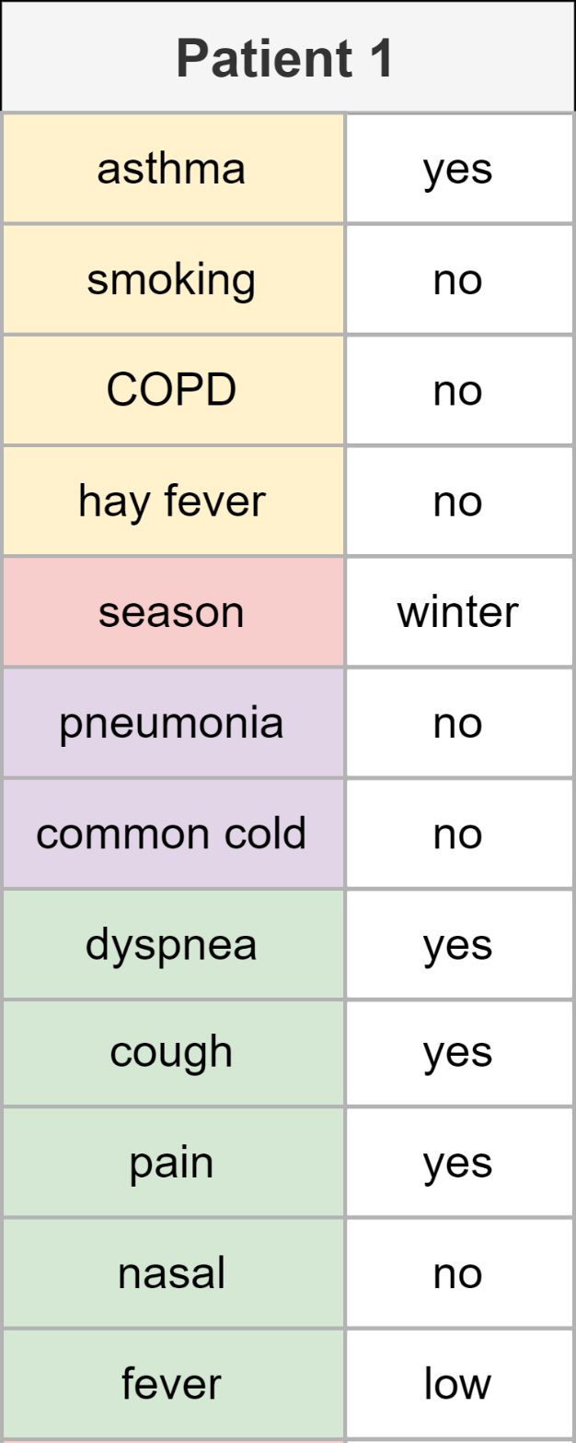
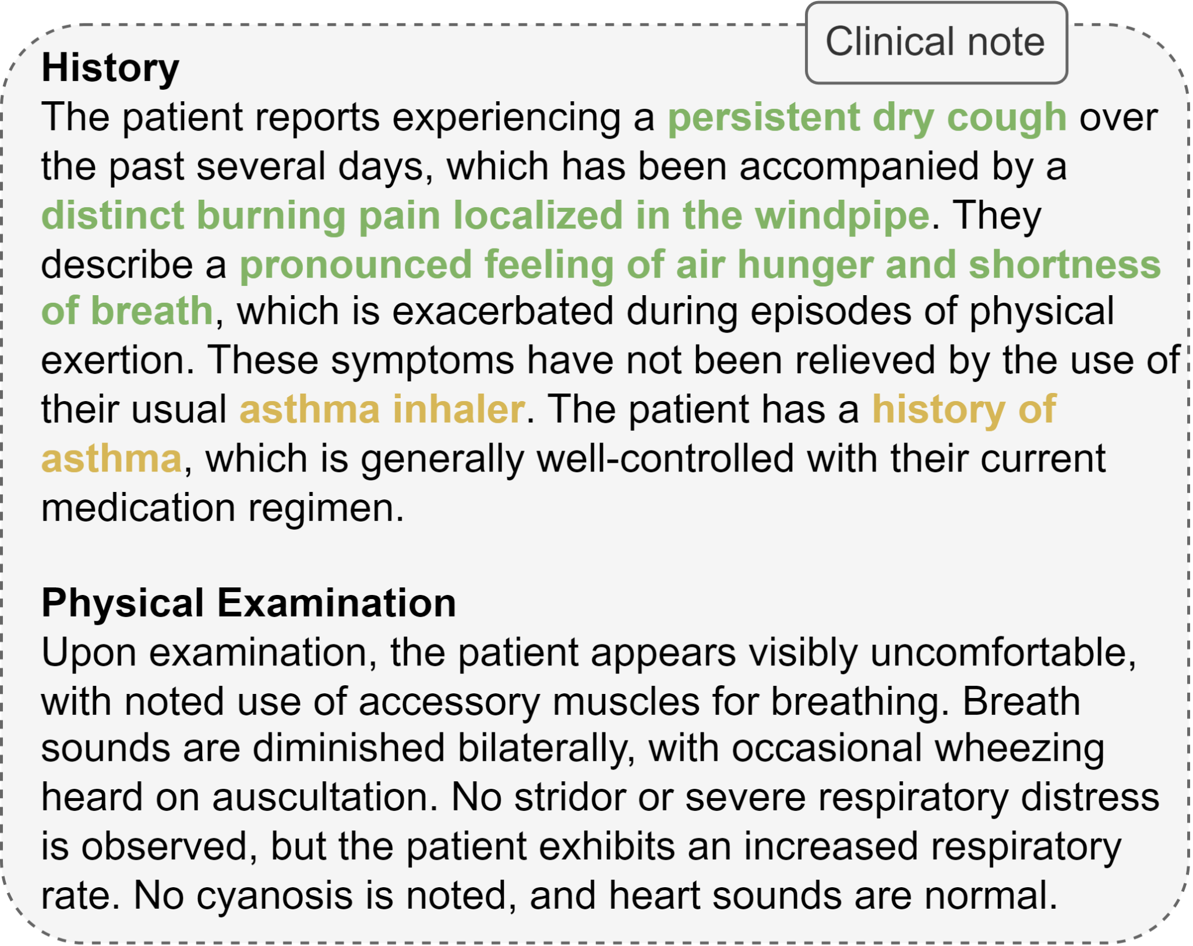
Larger Bayesian network: SimSUM
SimSUM: Simulated dataset with Structured and Unstructured Medical records
Notes:
This network, which we call the SimSUM network, also helps us address another issue, which is that it’s hard to find datasets where both structured data and unstructured text data are available for the same set of patients. We therefore used this Bayesian network to simulate a dataset with structured patient records, containing information on their background, symptoms, and more. We additionally used large language models to generate clinical notes that correspond to this structured data. This dataset is published online and can be used to perform research on the topic of structured and unstructured medical data.

Slide 72
SimSUM – Simulated dataset with Structured and Unstructured Medical records
Notes:
In that dissertation, you will also find that I did a lot more than I had time to address in this presentation. In this presentation, I showed quite a simple Bayesian network. But in my work, this is the actual network that I worked with, which is bigger and contains a wider variety of nodes. My co-supervisor Stefan designed this network for the use case of respiratory diseases in primary care.

Slide 73
SimSUM – Simulated dataset with Structured and Unstructured Medical records
Notes:
We even used this Bayesian network to simulate a dataset with structured patient records, containing information on their background, symptoms, and more. We additionally used large language models to generate clinical notes that correspond to this structured data. This dataset is published online and can be used to perform research on the topic of structured and unstructured medical data.

Slide 74
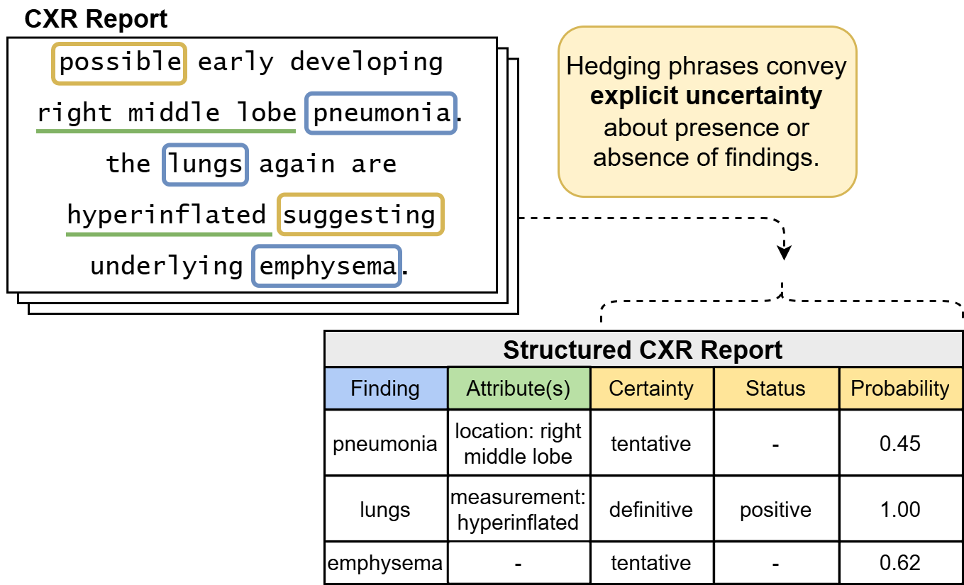
Modeling clinical uncertainty in radiology reports
Notes:
Another topic I did not have time to elaborate on, is the extraction of uncertainty from language. I already told you about clinical information extraction, where we try to turn unstructured text into a structured format. In a research project that I started while I was staying in Korea, I applied this idea to radiology reports. These reports are very dense and contain a lot of information, so we tried to structure this information. While doing so, we noticed that the radiologists who wrote the reports, used a lot of language that conveyed uncertainty. They use hedging phrases like “possible” or “suggesting”. In this project, we extracted these words, and developed an algorithm to map them to probabilities. We also publish this dataset online, so people can use it for their own research.

Slide 75
Part 5
Conclusion
Notes:
To summarize, let’s go over the main points of everything that I explained to you today.

Slide 76
Augmenting Bayesian Networks
with Textual Evidence
for Expert-Based, Uncertainty-Aware
Clinical Decision Support
1.
Notes:
First, I told you about the use case of diagnosis in primary care, and how this is all based on the process of clinical reasoning. I told you that we could build an AI system that can support the doctor in their clinical reasoning.

Slide 77
Augmenting Bayesian Networks
with Textual Evidence
for Expert-Based, Uncertainty-Aware
Clinical Decision Support
2.
1.
Doctor and patient
trust the system
2.
The system is uncertainty-aware
Notes:
Then, I told you about two requirements for this system, which is the fact that both doctor and patient must trust the system. We can achieve this by making our system interpretable and expert-based. The system must be uncertainty-aware, so it can be integrated in the clinical reasoning process of the doctor.

Slide 78
3.
Augmenting Bayesian Networks
with Textual Evidence
for Expert-Based, Uncertainty-Aware
Clinical Decision Support
Difficulty breathing
Pneumonia
Cough
Common cold
Fever
Runny nose
Notes:
Then, I showed you how a Bayesian network is made up of an expert-defined causal structure and conditional probability tables, which makes it perfectly suited for solving these two requirements.

Slide 79
Augmenting Bayesian Networks
with Textual Evidence
for Expert-Based, Uncertainty-Aware
Clinical Decision Support
4.
Difficulty breathing
Pneumonia
Cough
Common cold
Fever
Runny nose
Notes:
Finally, I told you about the importance of clinical text, and showed you how it can be integrated into the Bayesian network.

Slide 80
Thank you!
Notes:
I hope I have been able to show you that AI is more than ChatGPT, that Bayesian networks are powerful and elegant AI models that are perfectly suited for clinical decision support, and that AI can enrich healthcare by supporting doctors, rather than replacing them.

Slide 81
Augmenting Bayesian Networks with Textual Evidence
for Expert-Based, Uncertainty-
Aware Clinical Decision Support
Doctoral dissertation of Paloma Rabaey
Public defense
24/02/2026

